Slide 1
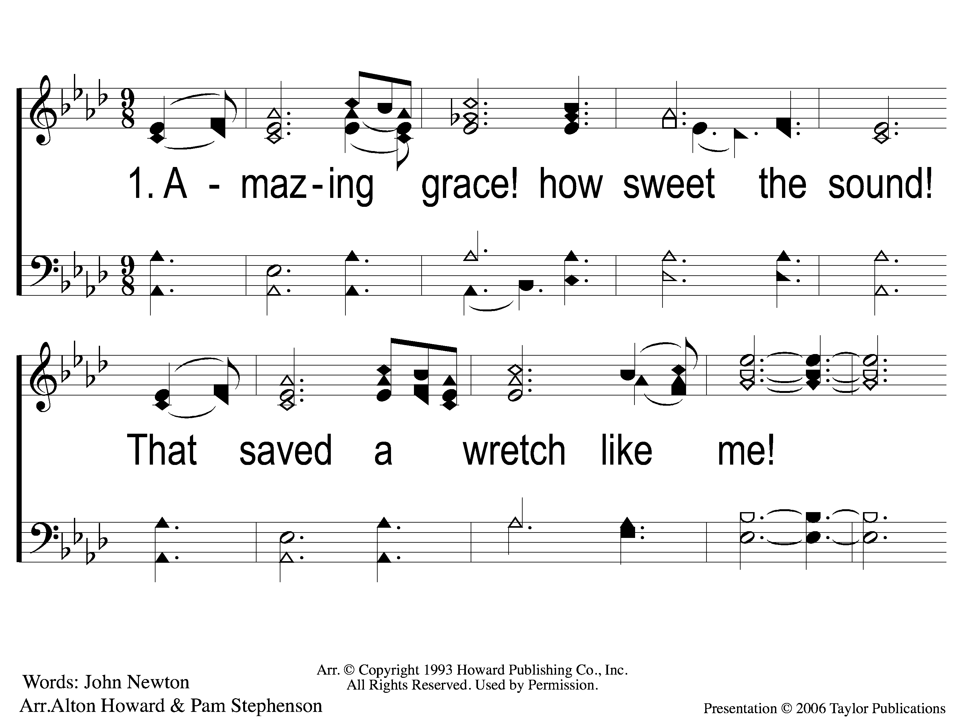
1-1 Amazing Grace
Amazing Grace
129

Slide 2
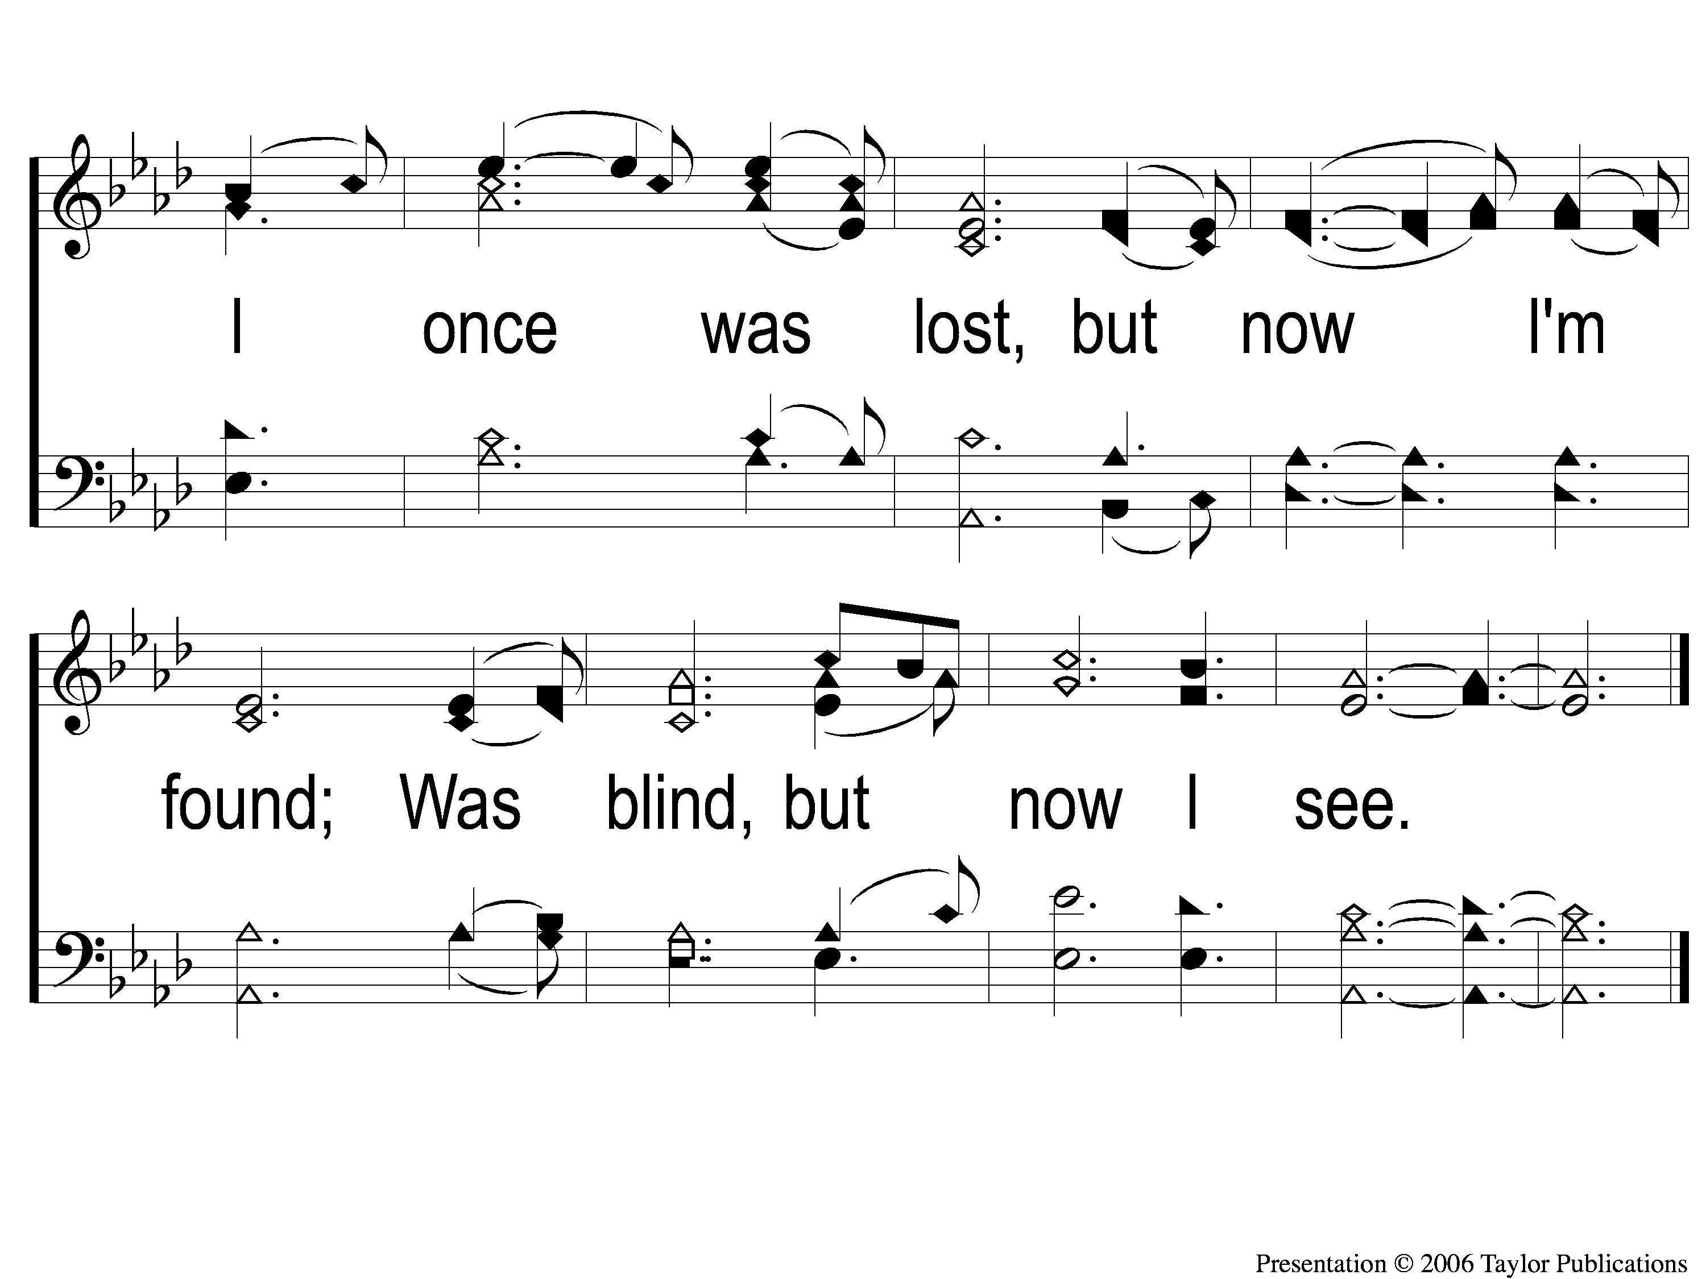
1-2 Amazing Grace
Amazing Grace
129

Slide 3
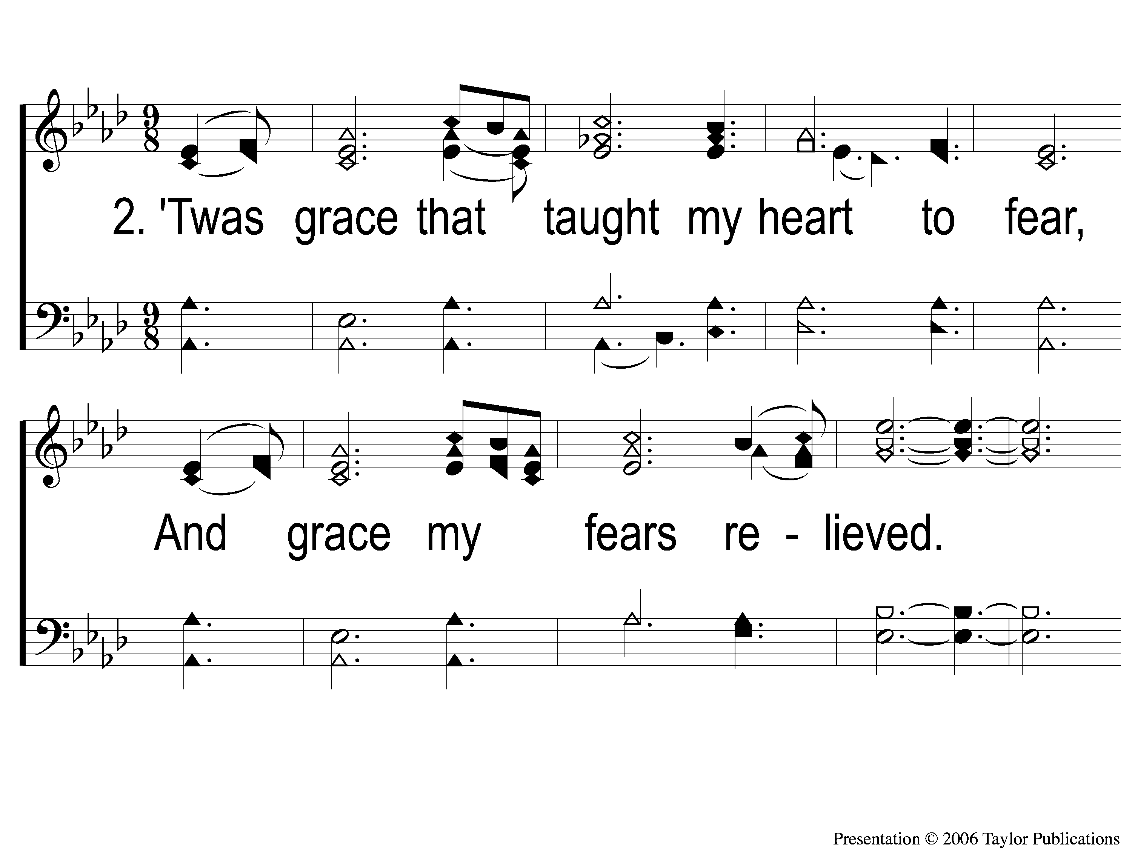
2-1 Amazing Grace
Amazing Grace
129

Slide 4
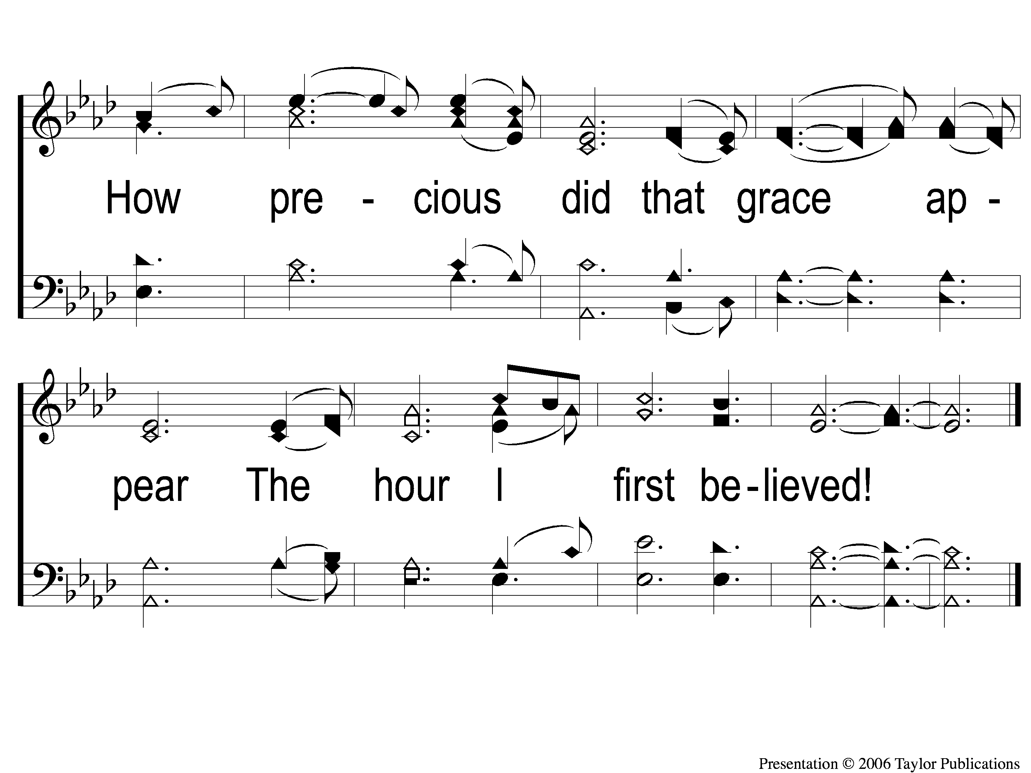
2-2 Amazing Grace
Amazing Grace
129

Slide 5
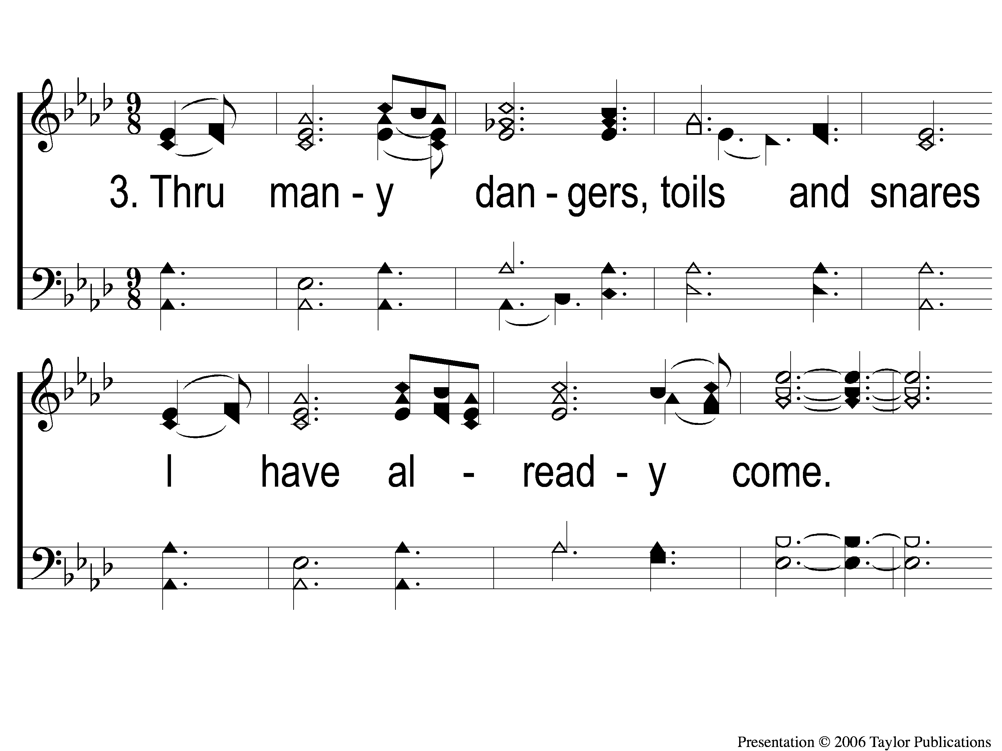
3-1 Amazing Grace
Amazing Grace
129

Slide 6
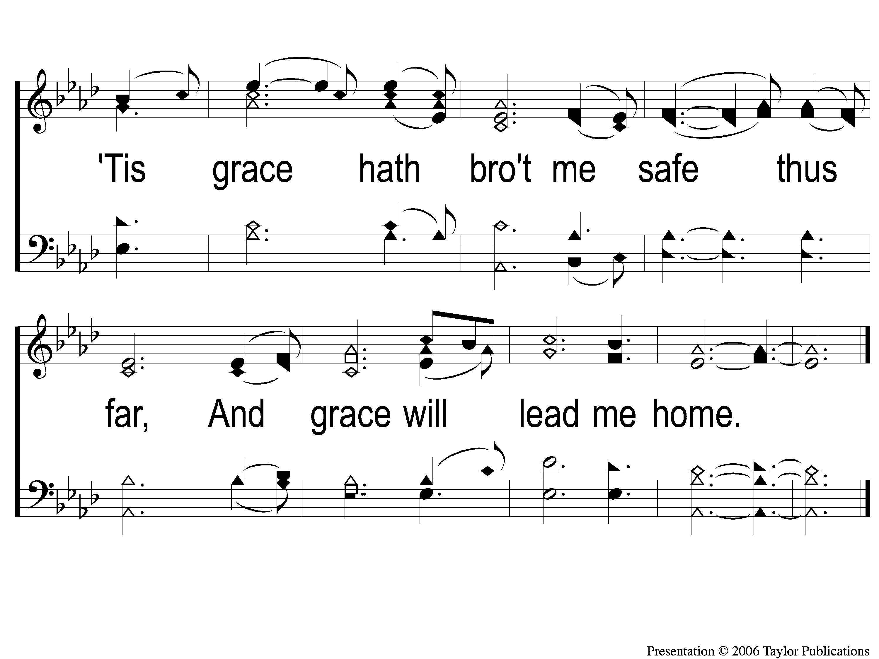
3-2 Amazing Grace
Amazing Grace
129

Slide 7
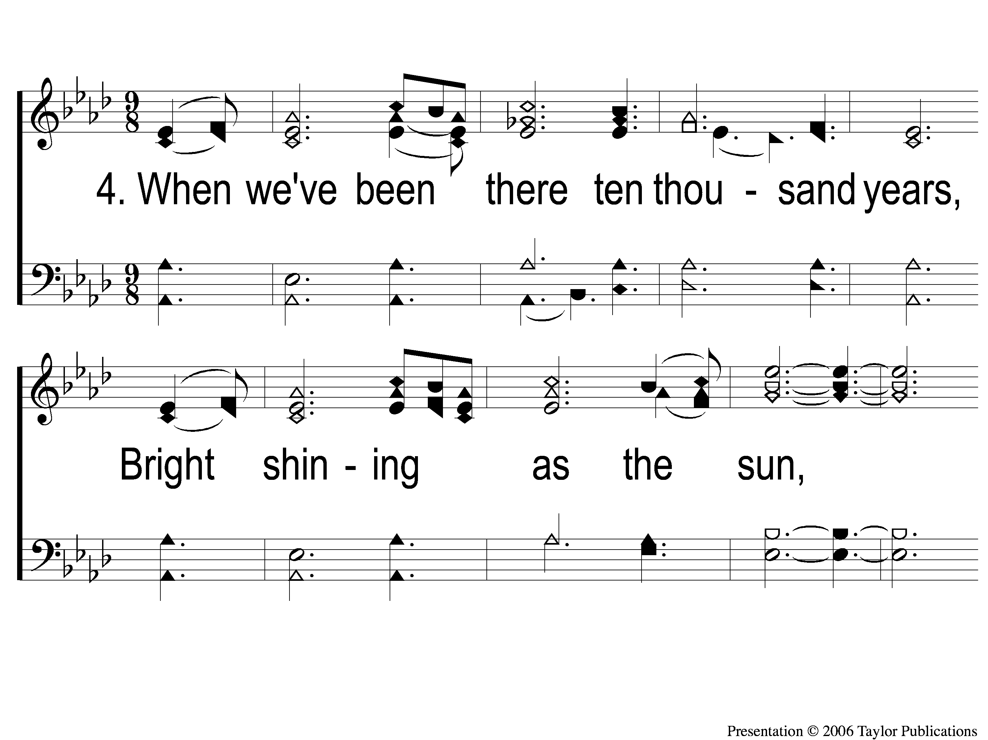
4-1 Amazing Grace
Amazing Grace
129

Slide 8
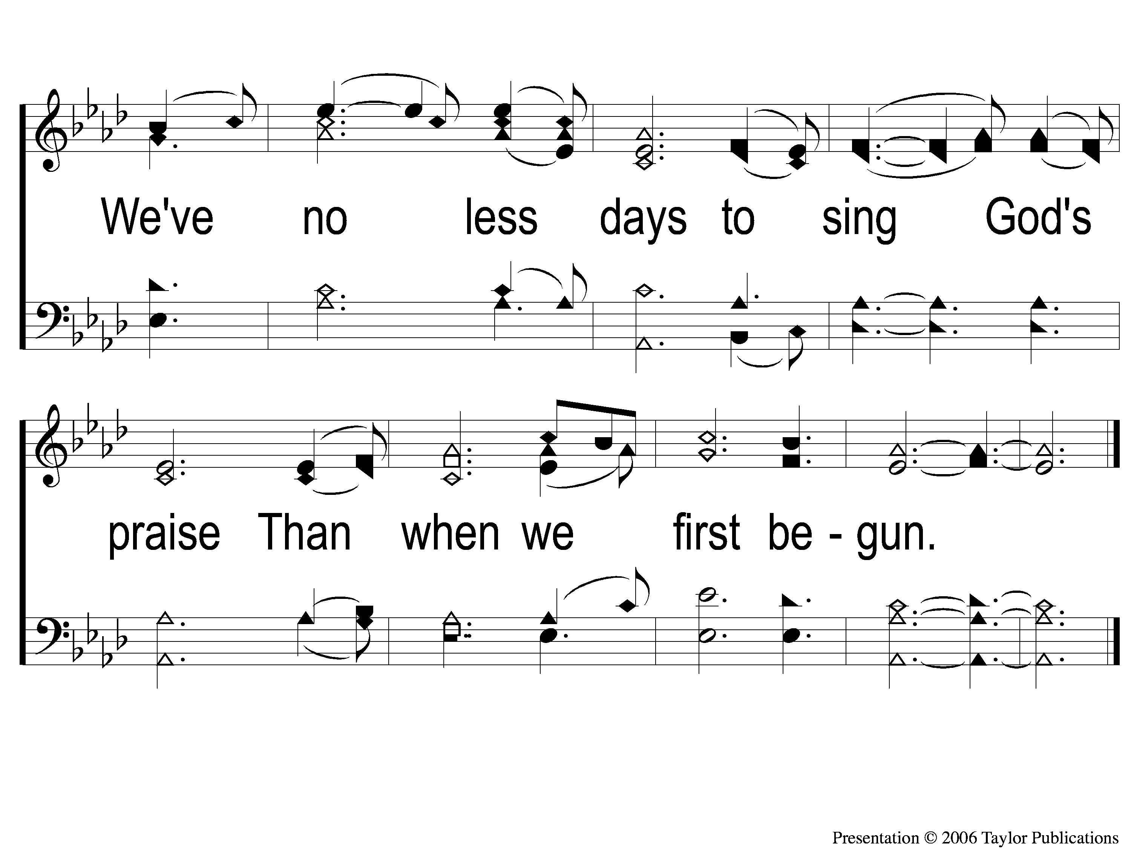
4-2 Amazing Grace
Amazing Grace
129

Slide 9
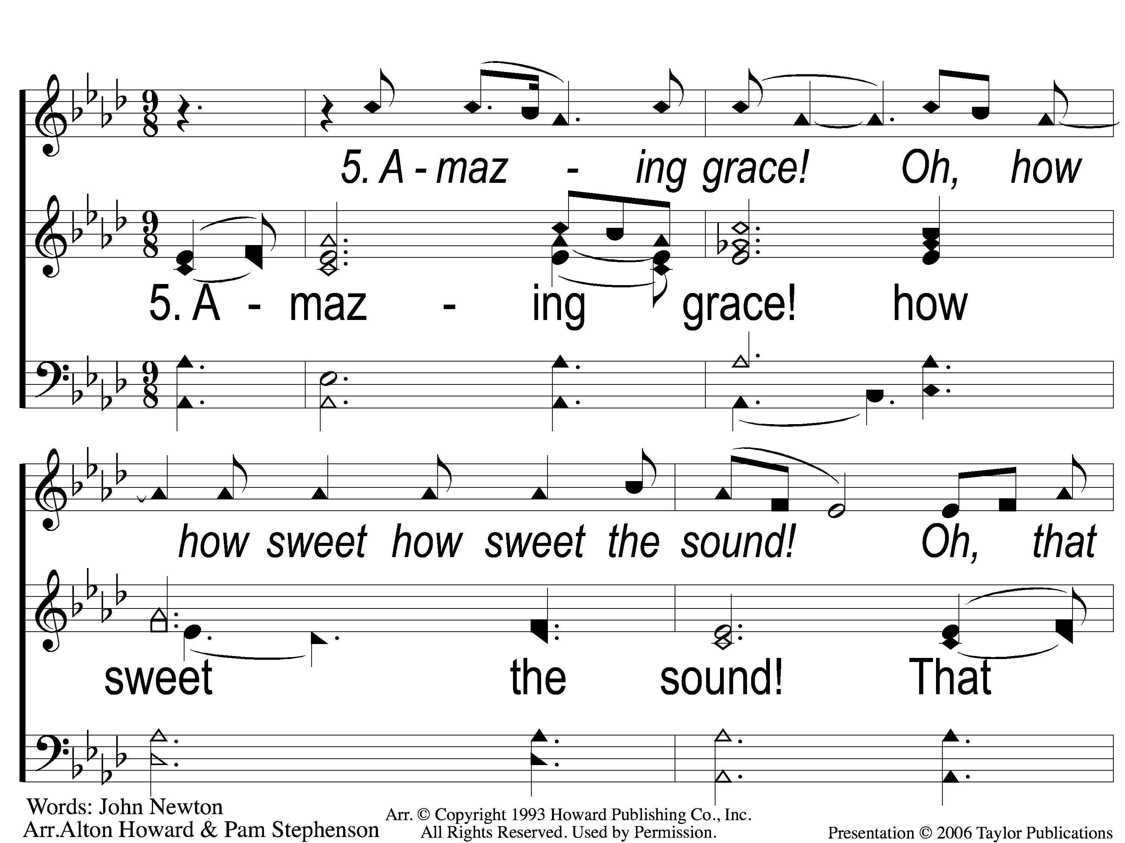
Opt 5-1 Amazing Grace
Amazing Grace
129

Slide 10
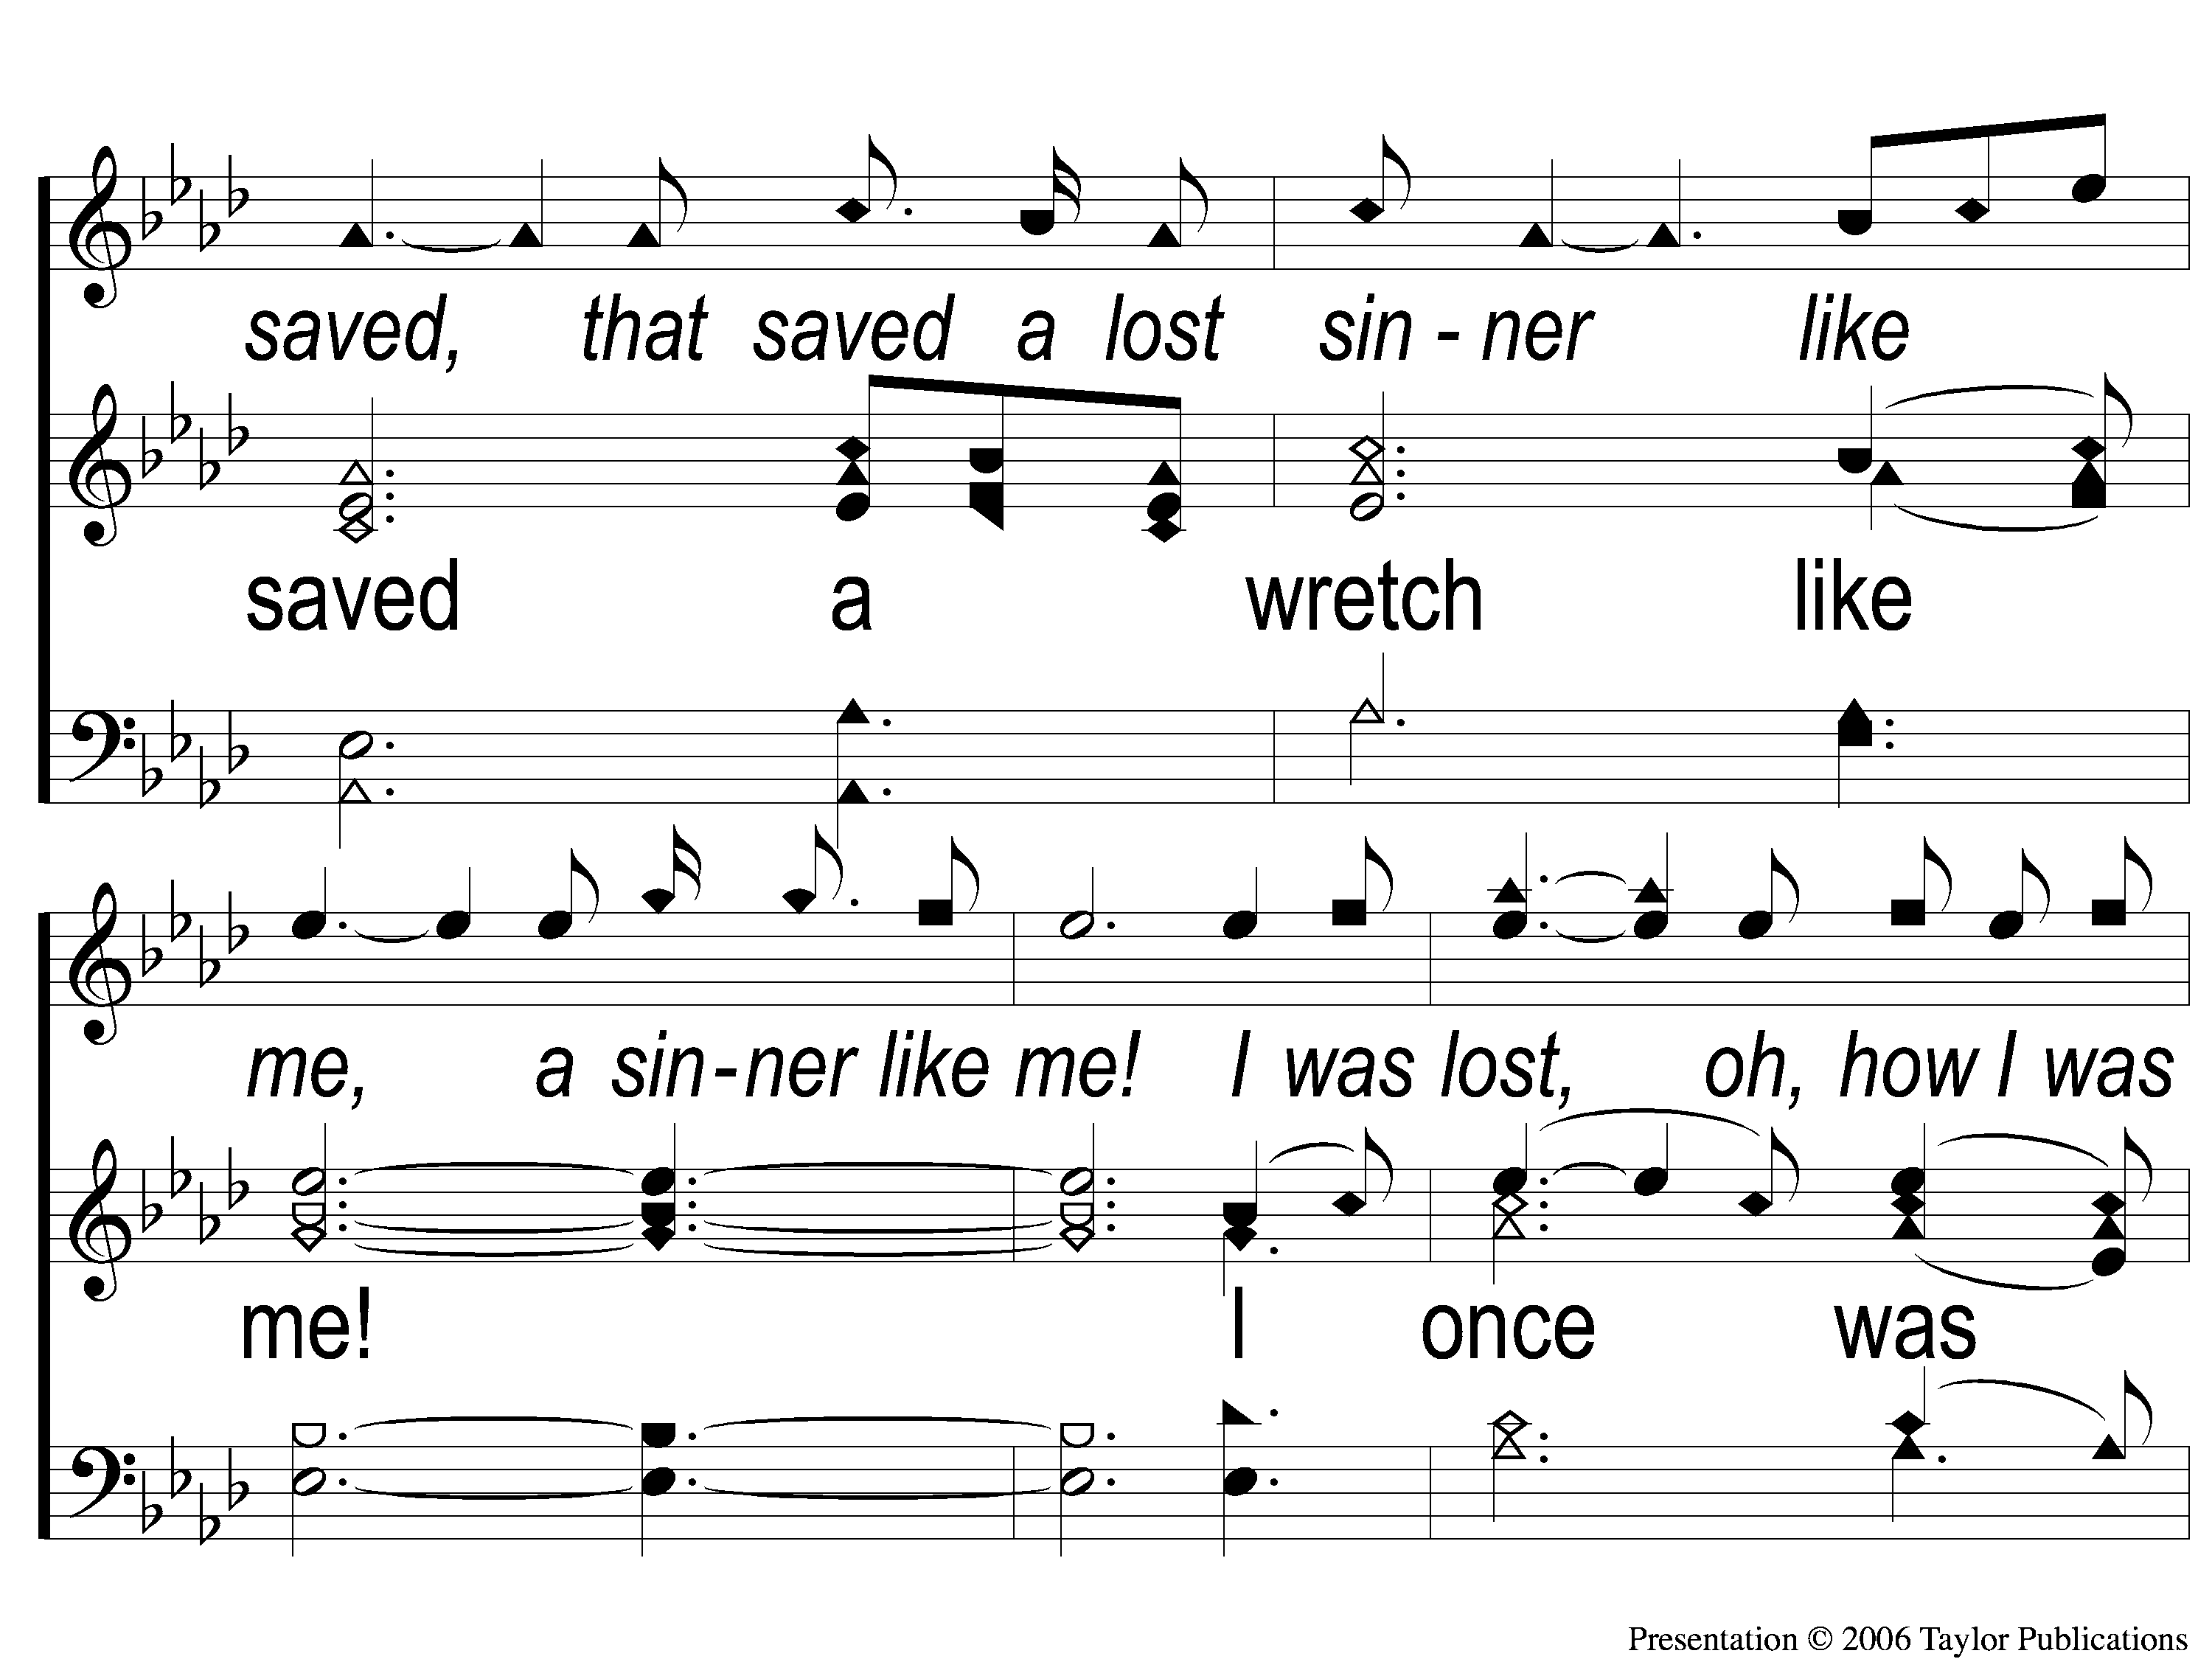
Opt 5-2 Amazing Grace
Amazing Grace
129

Slide 11
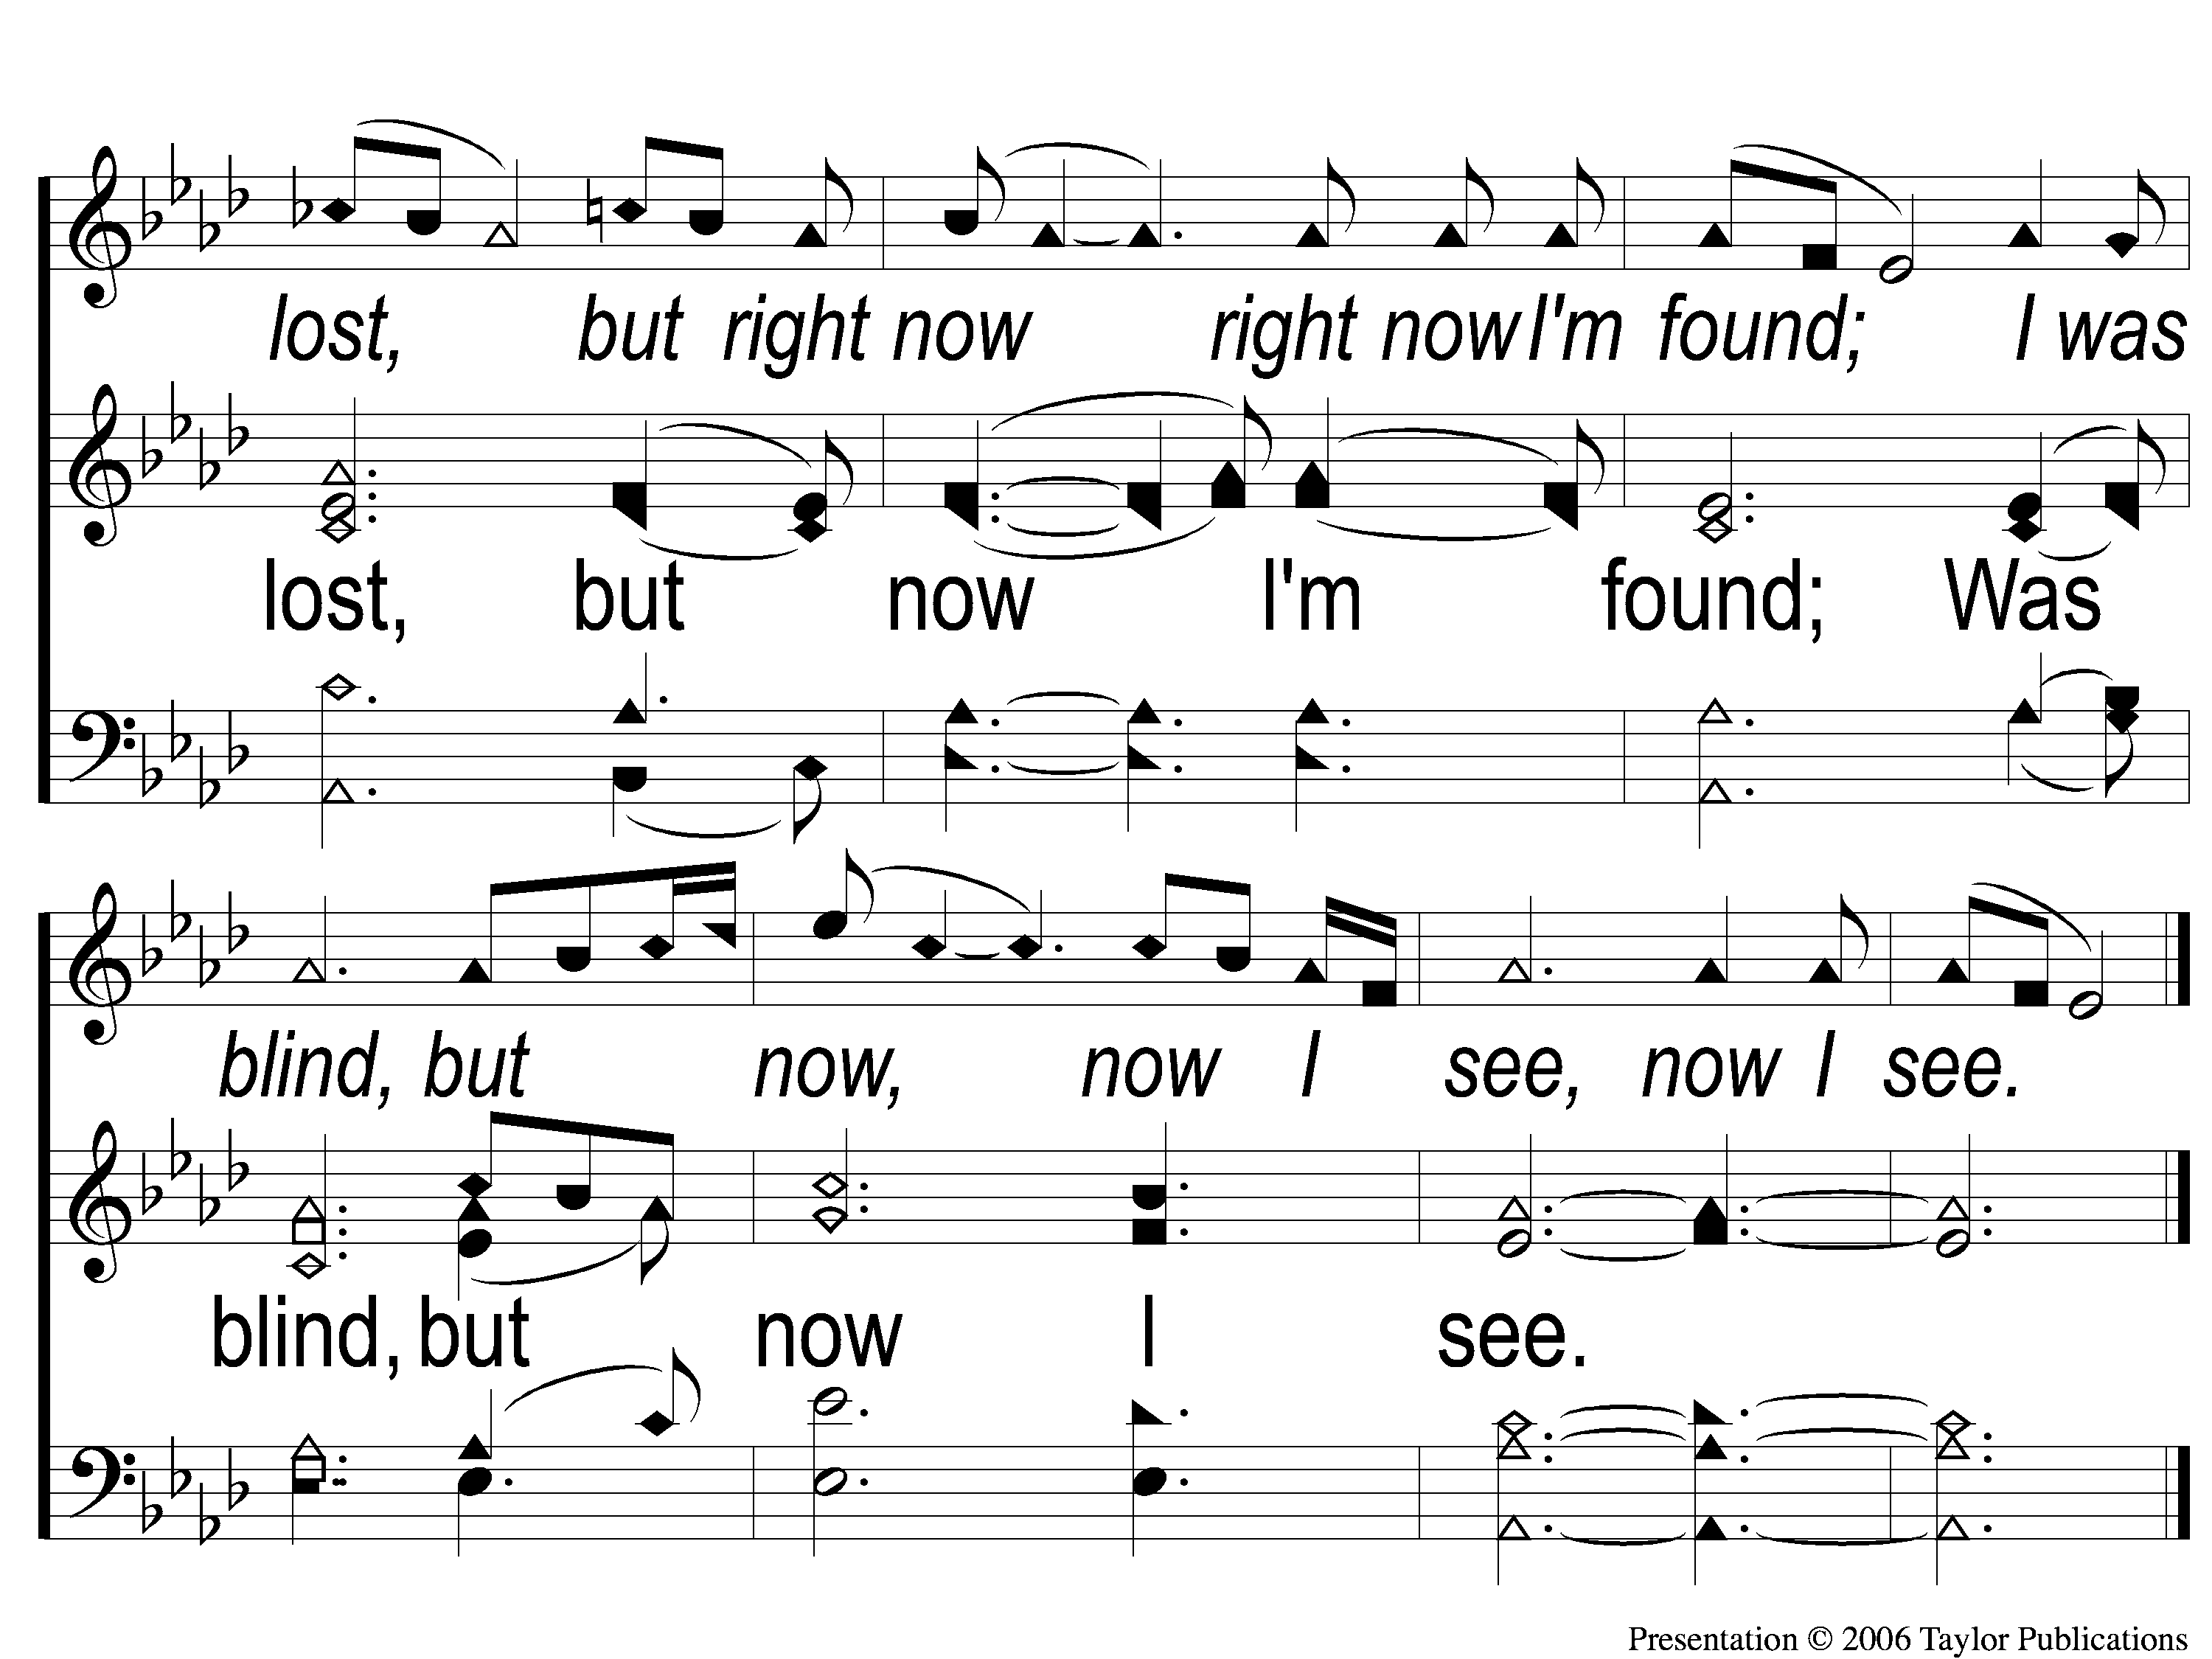
Opt 5-3 Amazing Grace
Amazing Grace
129

